Slide 1

Romberg Integration
Group - Perseus

Slide 2
Group Members
Name
ID
MD. Jamiur Rahman Khan
2024100000162
Antor Sikder
2024100000165
Oyshie Ahmed
2024100000188
Nurjahan Khanom Mim
2024100000230
Mehedi Hasan Omi
2024100000254
Md. Mezbahuzzaman Rana
2024100000481
Md Shah Naohaj Khan
2024100000487
Abdul Ahad Emon
2024100000490
Rehan Khadem
2024100000512
Sarhan Saad
2024100000520

Slide 3







Presentation Outline
Introduction & Problem Statement
Composite Trapezoidal Rule
Romberg Integration
Simpson's 1/3 Rule
Error & Convergence Analysis
Comparison of Results
Discussion & Conclusion

Slide 4

Introduction to Numerical Integration
Numerical integration is a way to find the approximate value of an integral when it is hard or impossible to solve exactly.
In this presentation, we will use different numerical methods to calculate the integral of f(x) = sin(x) from 0 to 1 and compare the results with the exact value.
We will delve into three key methods:
Composite Trapezoidal Rule
Simpson's 1/3 Rule
Romberg Integration

Slide 5
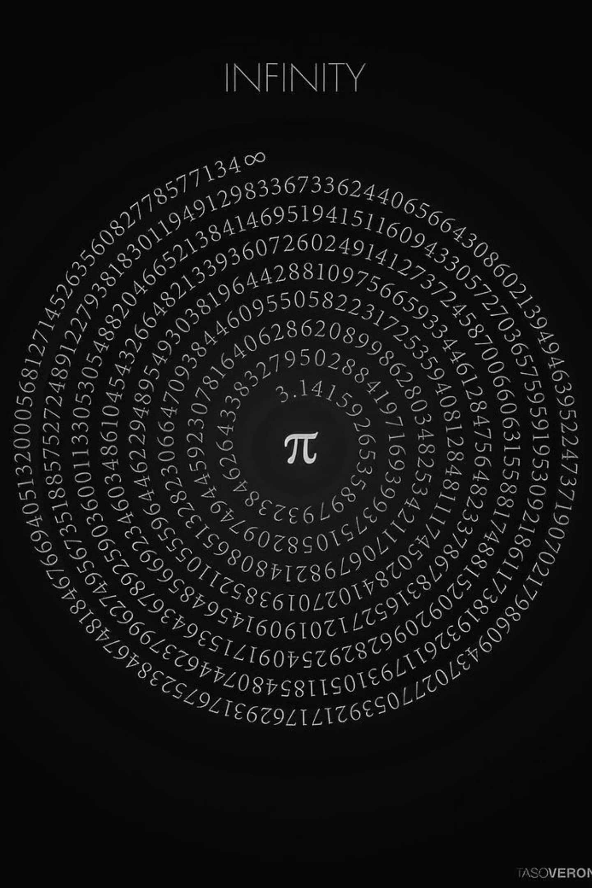
Problem Statement: Integrating sin(x)
Our objective is to accurately approximate the definite integral of the sine function over a specific interval and then evaluate the performance of various numerical methods.
Function
Exact Value
f(x) = sin(x)
1 - cos(1) \approx 0.4596976941
Interval
Goal
[0, 1]
Compare accuracy and convergence rates of the Trapezoidal, Simpson's, and Romberg methods.

Slide 6
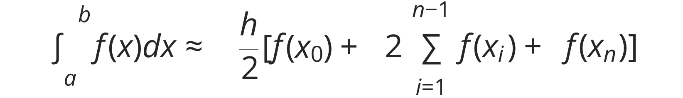

Composite Trapezoidal Rule: Theory
The Composite Trapezoidal Rule approximates the integral by dividing the area under the curve into several trapezoids. It's a foundational method in numerical integration.
Order of Error:
The error of the Composite Trapezoidal Rule is proportional to O(h^2). This means that as h (the step size) decreases, the error decreases quadratically.
Formula:
n: Number of subintervals
h: Width of each subinterval h = (b-a)/n
x_i: Points along the interval, x_i = a + ih

Slide 7
Composite Trapezoidal Rule: Application
The Composite Trapezoidal Rule is used to approximate a definite integral by dividing the interval into many small subintervals and applying the trapezoidal rule to each part. Increasing the number of subintervals improves the accuracy of the result.
Let's apply the Composite Trapezoidal Rule to \int_0^1 sin(x) dx with n=4.
Parameters:
Points & Values:
Result:
n = 4
Using the formula, the approximation is:
h = (1-0)/4 = 0.25
0
0.0000000000
0.4573009376
0.25
0.2474039593
Absolute Error: 0.0023967571
0.50
0.4794255386
0.75
0.6816387600
1.00
0.8414709848

Slide 8
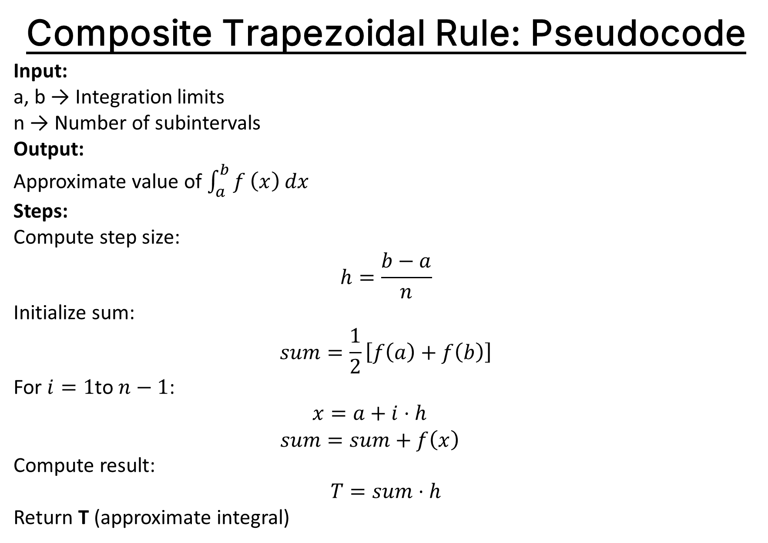
Composite Trapezoidal Rule: Pseudocode
Input:
a, b → Integration limits
n → Number of subintervals
Output:
Approximate value of $\int_{a}^{b}{f}\left(x\right) dx$
Steps:
Compute step size: $$h=\frac{b−a}{n}$$
Initialize sum: $$sum=\frac{1}{2}\left[f\left(a\right)+f\left(b\right)\right]$$
For $i=1$to $n−1$:
$$x=a+i⋅h$$
$$sum=sum+f\left(x\right)$$
Compute result: $$T=sum⋅h$$
Return T (approximate integral)

Slide 9
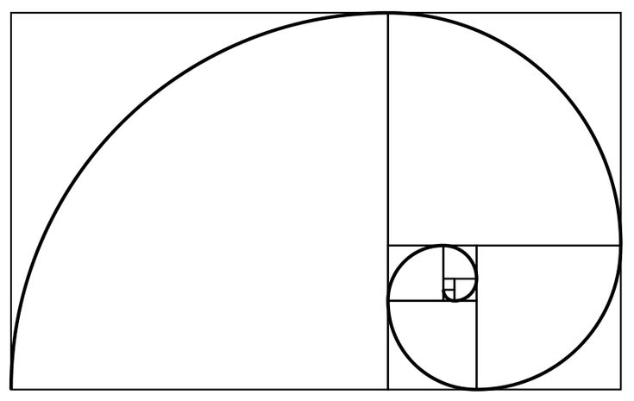

Romberg Integration: Concept
Romberg Integration is a powerful technique that significantly enhances the accuracy of the Trapezoidal Rule by using Richardson Extrapolation.
What is Romberg Integration?
It's an iterative method that combines multiple Trapezoidal Rule approximations (with different step sizes) to progressively eliminate lower-order error terms, yielding a much more accurate result.
Richardson Extrapolation:
The core idea is to use two approximations, I(h) and I(h/2), to form a new, more accurate approximation that has a higher order of accuracy.
Why it improves Trapezoidal Rule:
Systematically cancels out error terms.
Achieves very fast convergence rates.
Effectively increases the order of accuracy.

Slide 10
Romberg Integration Table for sin(x)
The Romberg table systematically calculates more accurate approximations. Each column represents a higher order of accuracy.
0
0.459670119
1
0.459691902
0.459699109
2
0.459697078
0.459698774
0.4596976941
The value 0.4596976941 (highlighted) is obtained after just a few iterations and matches the exact value very closely.
Result: 0.4596976941
Absolute Error: \approx 0

Slide 11
Romberg Integration: Pseudocode
Input:
a, b → Integration limits
L → Maximum level
Output:
Romberg table R
Best approximation of ∫ f(x) dx from a to b
Steps:
Create a 2D array R[0..L][0..L]
For k = 0 to L:
Set n = 2^k
Compute: R[k][0] = Trapezoidal(a, b, n)
For j = 1 to k:
Compute: R[k][j] = R[k][j-1] + (R[k][j-1] - R[k-1][j-1]) / (4^j - 1)
End loops
Return R (Best approximation is R[L][L])

Slide 12
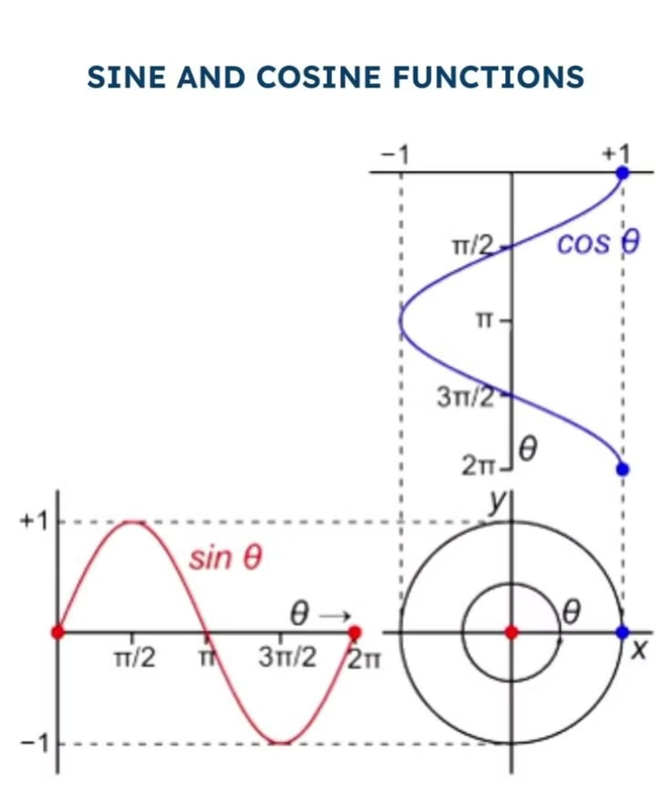

Simpson's 1/3 Rule: Theory
Simpson's 1/3 Rule is another powerful numerical integration method that uses quadratic polynomials to approximate the function. It typically offers better accuracy than the Trapezoidal Rule for the same number of subintervals.
Formula:
Key Requirements:
n must be even: This is crucial because Simpson's Rule approximates two subintervals at a time using a parabola.
Order of Error:
The error for Simpson's 1/3 Rule is O(h^4). This makes it significantly more accurate than the Trapezoidal Rule, meaning error decreases much faster as h is reduced.

Slide 13
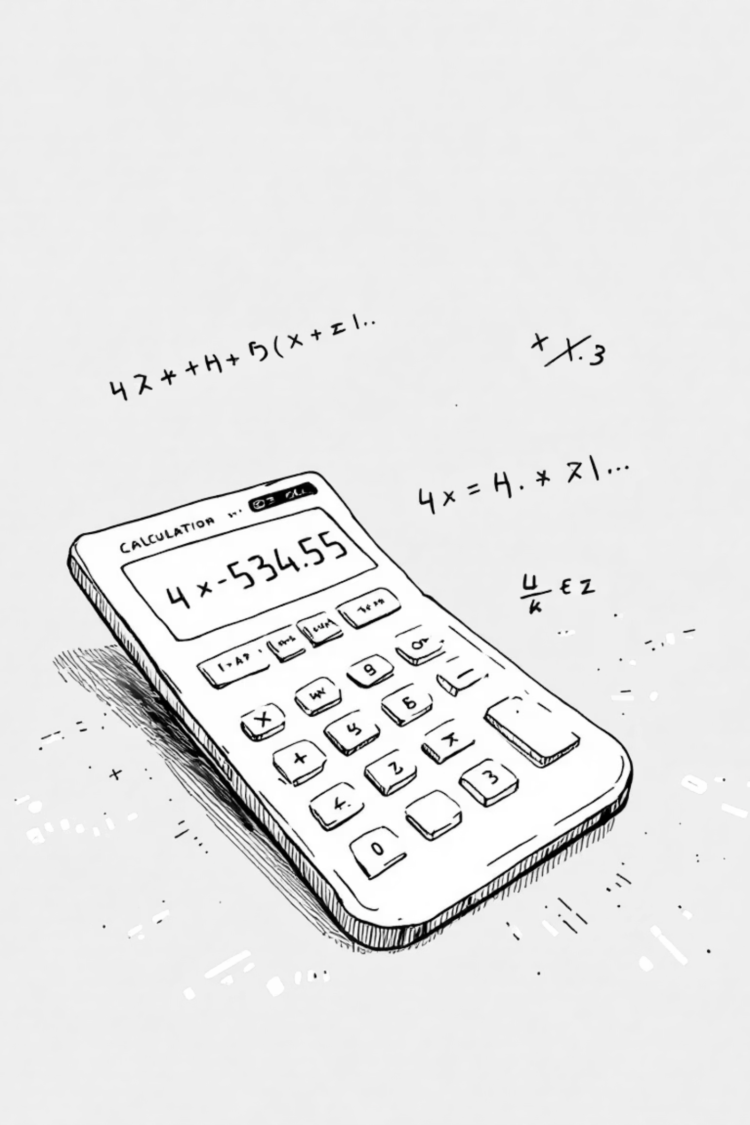
Simpson's 1/3 Rule: Application
Applying Simpson's 1/3 Rule to \int_0^1 sin(x) dx with n=4.
Parameters:
Calculation Highlights:
n = 4 (even, as required)
We use the same function values as the Trapezoidal Rule, but with different weighting factors for the intermediate points.
h = 0.25
Result:
The approximation using Simpson's 1/3 Rule is:
0.4597077448
Absolute Error: 0.0000100507

Slide 14
Simpson's 1/3 Rule: Pseudocode
Input:
a, b → Integration limits
n → Even number of subintervals
Output:
Approximate value of ∫ f(x) dx from a to b
Steps:
Compute step size: h = (b - a) / n
Initialize sum: sum = f(a) + f(b)
For i = 1 to n - 1:
x = a + i * h
If i is even: sum = sum + 2 * f(x) Else: sum = sum + 4 * f(x)
Compute result: S = (h / 3) * sum
Return S

Slide 15



Error & Convergence Analysis
Understanding the order of error helps predict how quickly an approximation converges to the true value as the step size decreases.
Trapezoidal Rule
Simpson's 1/3 Rule
Romberg Integration
Error Order: O(h^2)
Error Order: O(h^4)
Error Order: O(h^{2k})
Convergence: Relatively slow, error reduces quadratically with h.
Convergence: Faster than Trapezoidal, error reduces as the fourth power of h.
Convergence: Very rapid, as it extrapolates to higher orders of accuracy. Can achieve machine precision with few iterations.
In simple terms, higher order of error means fewer steps (larger h) are needed to achieve a desired level of accuracy.

Slide 16
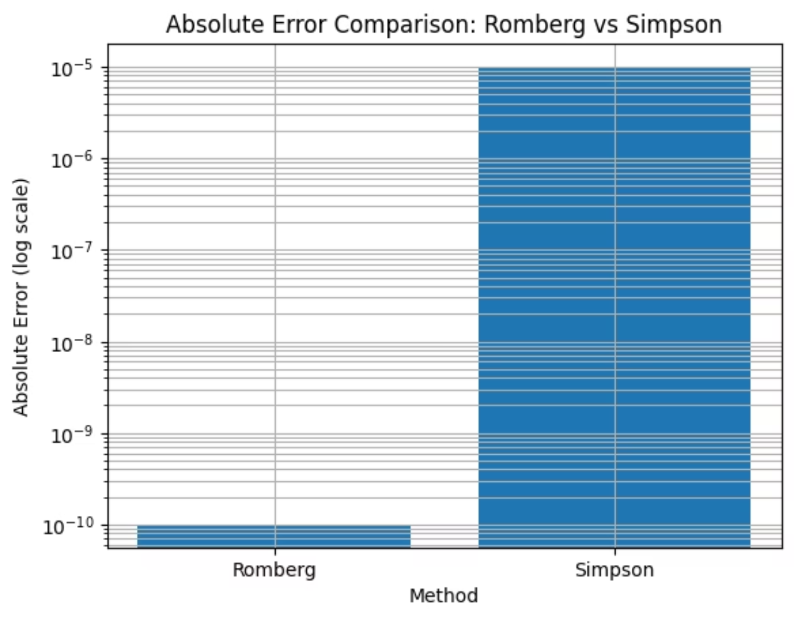
Error Decay Comparison Slide
This slide compares how fast the error decreases for the Trapezoidal Rule, Simpson’s Rule, and Romberg Integration. It shows that Romberg Integration reduces the error much faster than the other methods, while Simpson’s Rule performs better than the Trapezoidal Rule.

Slide 17
Conclusion:
We applied the Trapezoidal Rule, Simpson’s Rule, and Romberg Integration to approximate the integral of f(x) = sin(x) from 0 to 1.
The Trapezoidal Rule gives a simple but less accurate result.
Simpson’s Rule improves the accuracy significantly.
Romberg Integration provides the most accurate result with the fastest convergence.
Error analysis clearly shows that Romberg Integration is the best method among the three.
Therefore, the objectives of this project have been successfully achieved.

Slide 18


